Slide 1
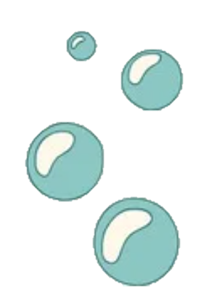
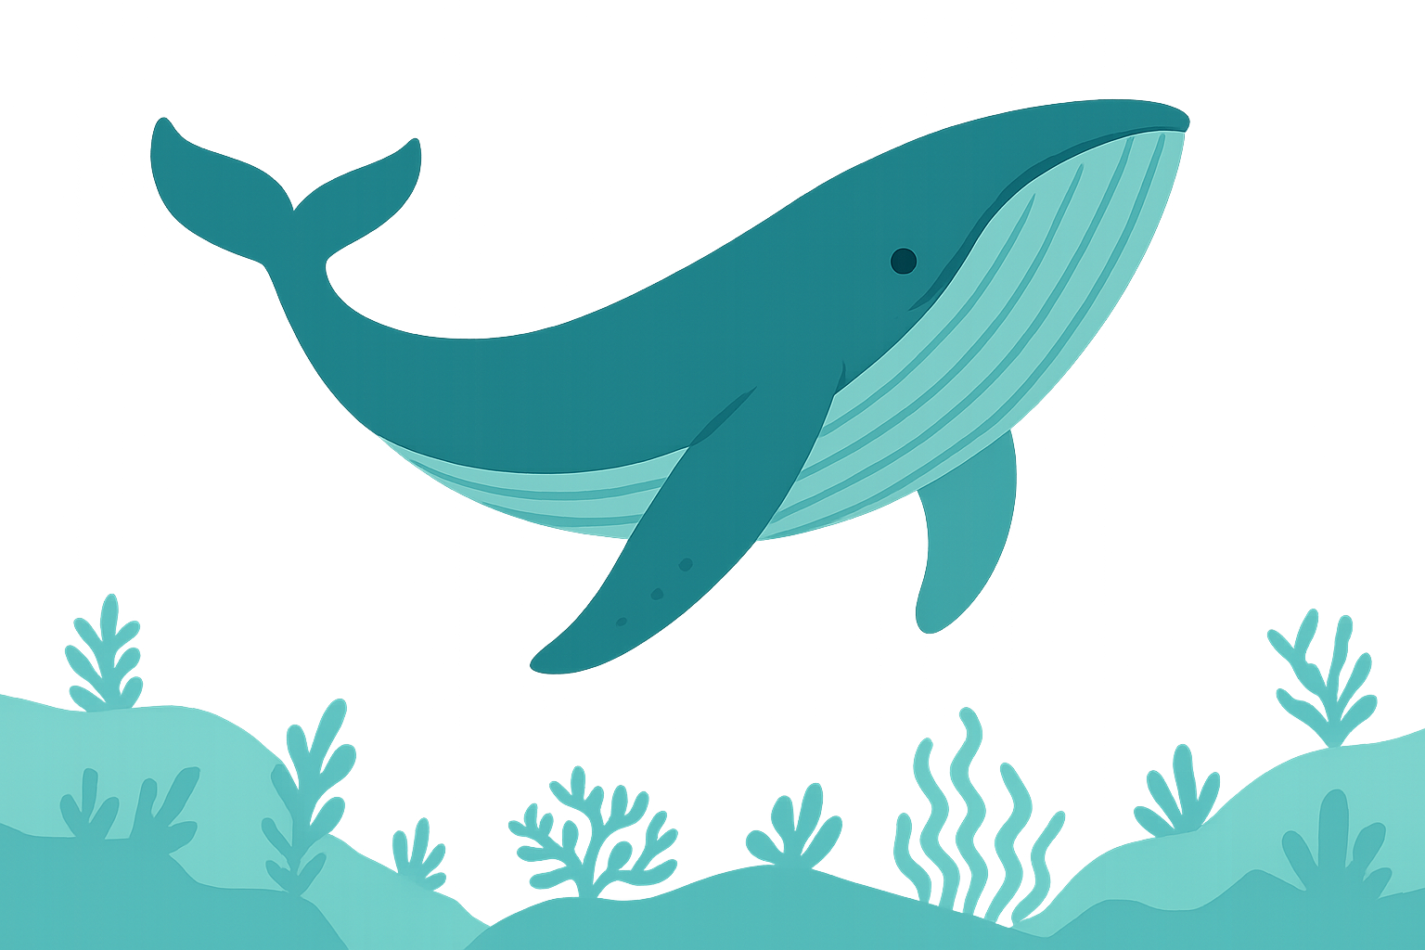
Cetacea
Vanishing Giants – Mapping the Past, Present, and Future of Cetacea
Where Were Whales
Camille Challier
Cyrill Strassburg
Eglantine Vialaneix
COM-480

Slide 2
Introduction
The idea for this project emerged from our shared interest in marine life and concern for ocean health. We were especially drawn to cetaceans, whales, dolphins, and porpoises, not only for their beauty and intelligence, but for what they reveal about our planet’s wellbeing. While data on these animals exists, it's often fragmented and hard to understand. To change that, we created Where Were Whales, a platform that makes cetacean information accessible, engaging, and visually rich, aiming to raise awareness about their evolution, current status, and the threats they face today.
Motivation:
Our primary goal is to foster awareness and appreciation for cetaceans through interactive, data-driven storytelling. By visualizing key aspects such as global species distribution, extinction status, evolutionary relationships, sighting patterns, and cumulative threats, we aim to make complex information approachable and impactful. The project is designed for a wide audience, from marine biology enthusiasts to educators, conservationists, and curious minds, inviting users to explore and understand the delicate balance these marine mammals rely on. Through this engaging platform, we hope to spark interest, encourage informed dialogue, and ultimately contribute to stronger conservation efforts for cetaceans worldwide.
Goal:

Slide 3
II. Design and Development Process
After setting our goals, we focused on brainstorming effective ways to visualize and communicate the data, with the aim of raising awareness about cetacean protection. In this section, we retrace the steps taken to reach the final result, reusing sketches and plans from earlier milestones while explaining how they evolved throughout the development process.
Website layout
Our color palette, green and dark blue, was chosen to reflect the colors of the ocean, reinforcing our theme of marine life and cetacean protection. The green evokes shallow, vibrant waters and a sense of vitality, while the dark blue conveys depth, calm, and reliability. Paired with neutral backgrounds and black text for readability, this palette ensures a clean, engaging, and consistent visual experience throughout the site.
To support the visual narrative, we incorporated ocean-themed illustrations and icons sourced from Freepik, creating a cohesive design. Additionally, both the introduction and conclusion feature black and white images to highlight the urgency and danger faced by marine life. These monochrome visuals provide stark contrast, evoking a more serious, reflective tone that underscores the environmental threats at the heart of the project.
B) Storytelling
The website is structured to offer a clear, intuitive, and user-friendly experience, allowing visitors to navigate seamlessly through different sections. A top navigation bar provides direct access to the main parts of the site, while the overall layout follows a logical narrative that guides users step by step.
The journey begins with an introductory section that sets the stage: although more than a century has passed since the peak of commercial whaling, many cetacean species are still struggling to recover. This section highlights the urgency of their situation while offering a playful and engaging entry point into the topic.
After the introduction, users are invited to explore three interactive visualizations: sightings data, the cetacean phylogenetic tree, and individual species profiles. The main content then unfolds into a section that highlights the major threats cetaceans face today.
Finally, a concluding section wraps up the journey, summarizing the key insights and reinforcing the importance of cetacean conservation.

Slide 4
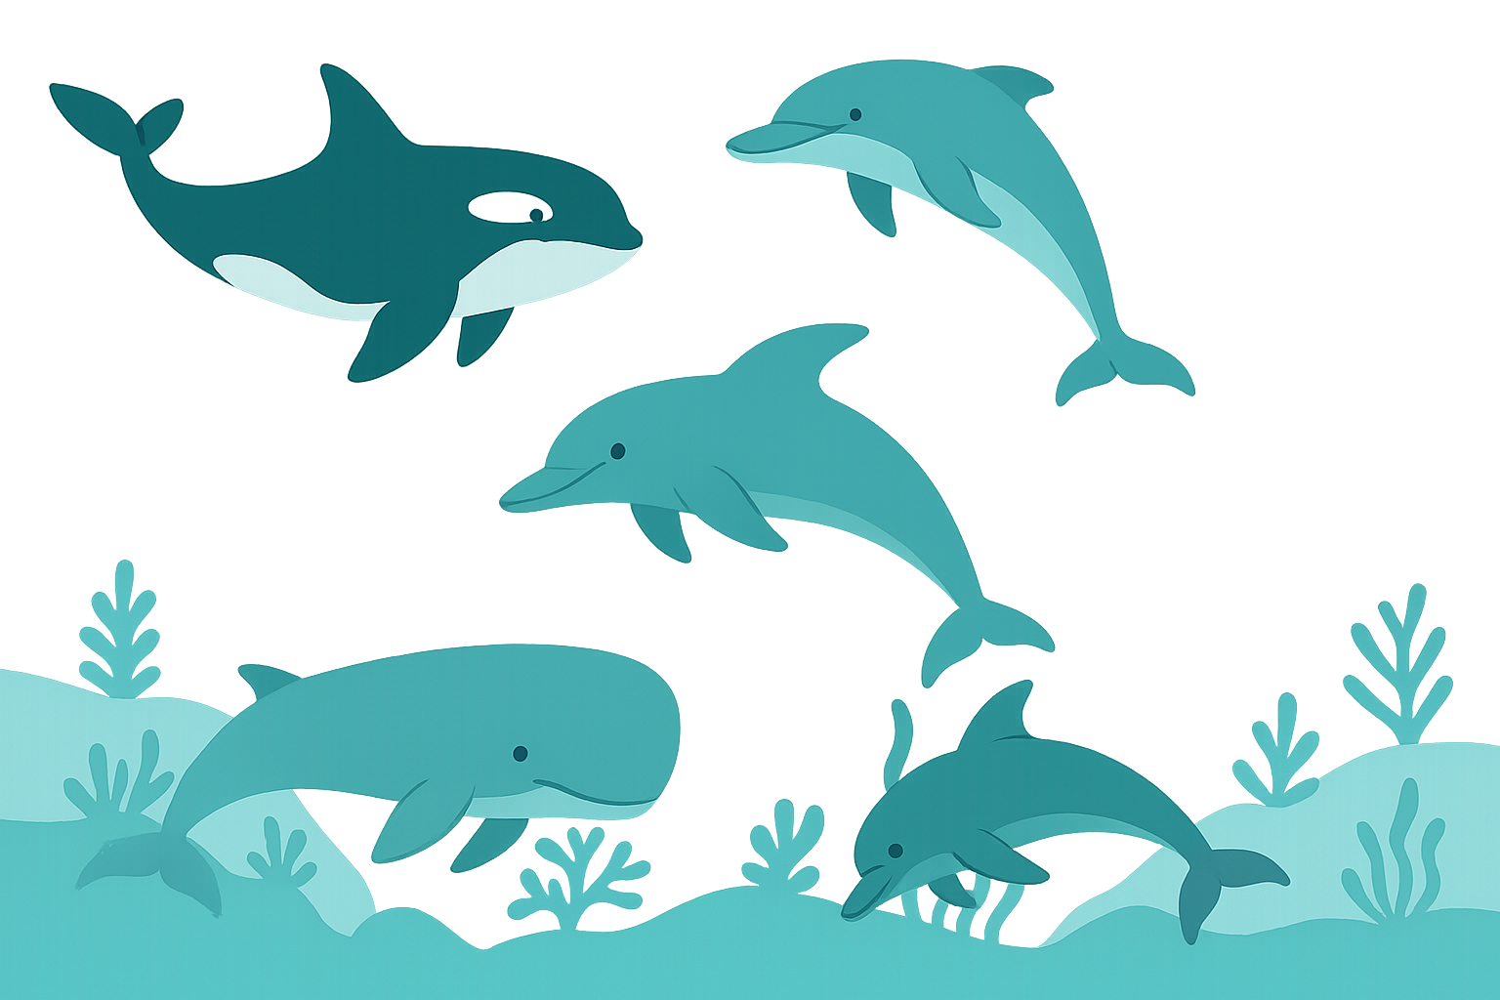
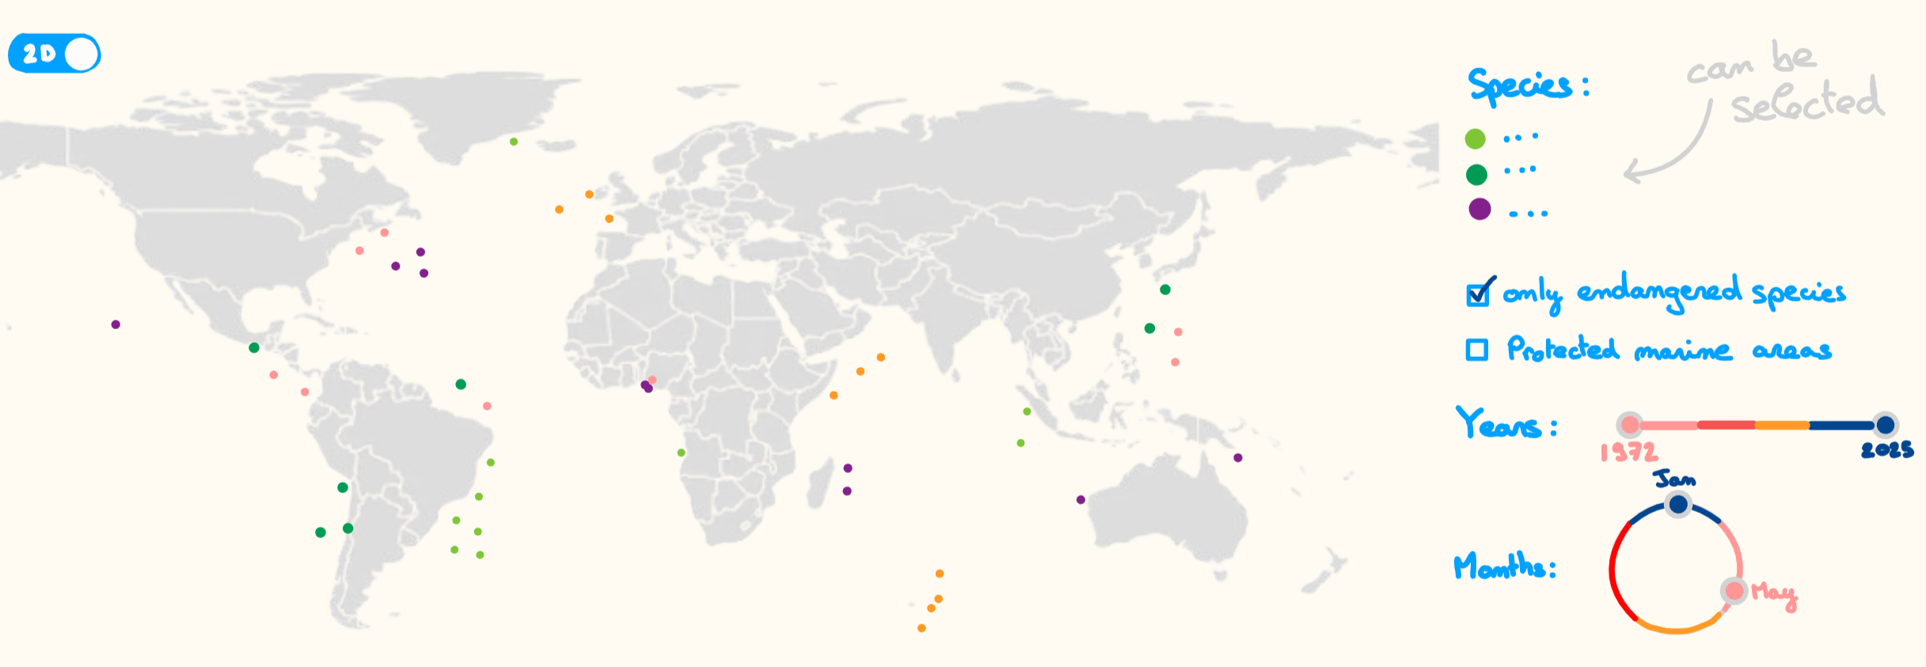
C) Visualizations
Sightings Map
Cetacean sightings data were sourced from OBIS Seamap, with original records provided by HappyWhale. We developed a dynamic map-based visualization that allows users to explore cetacean sightings in marine protected areas.
Key interactive features include:
Species selection (e.g., filter by specific cetaceans)
Conservation status filters (e.g., endangered species)
Seasonal filters to analyze migration patterns
Time range selectors to track changes over time
2D/3D toggle switch for flexible spatial perspectives
Since Milestone 2, we have made several design improvements. Protected areas are now represented with hatching instead of solid colors to reduce visual clutter and create clearer contrast with the colors used for species sightings. Additionally, we introduced a new functionality: users can now double-click on a species to isolate it on the map, allowing for more focused analysis. Instead of simply highlighting endangered species, we expanded the conservation status filter to allow users to select species based on IUCN Red List categories, specifically Endangered (EN&CR), and Vulnerable (VU).
What can we observe by playing with the map?
From May to November, sightings are more frequent in the northern regions; from November to May, they shift toward the south.
Sightings have increased over the years.
Some endangered species have very few recorded sightings, highlighting their rarity or detection challenges.
The main goal is to reveal critical overlaps (or gaps) between high-sighting regions and protected zones, while offering preliminary insights into species migration patterns.

Slide 5
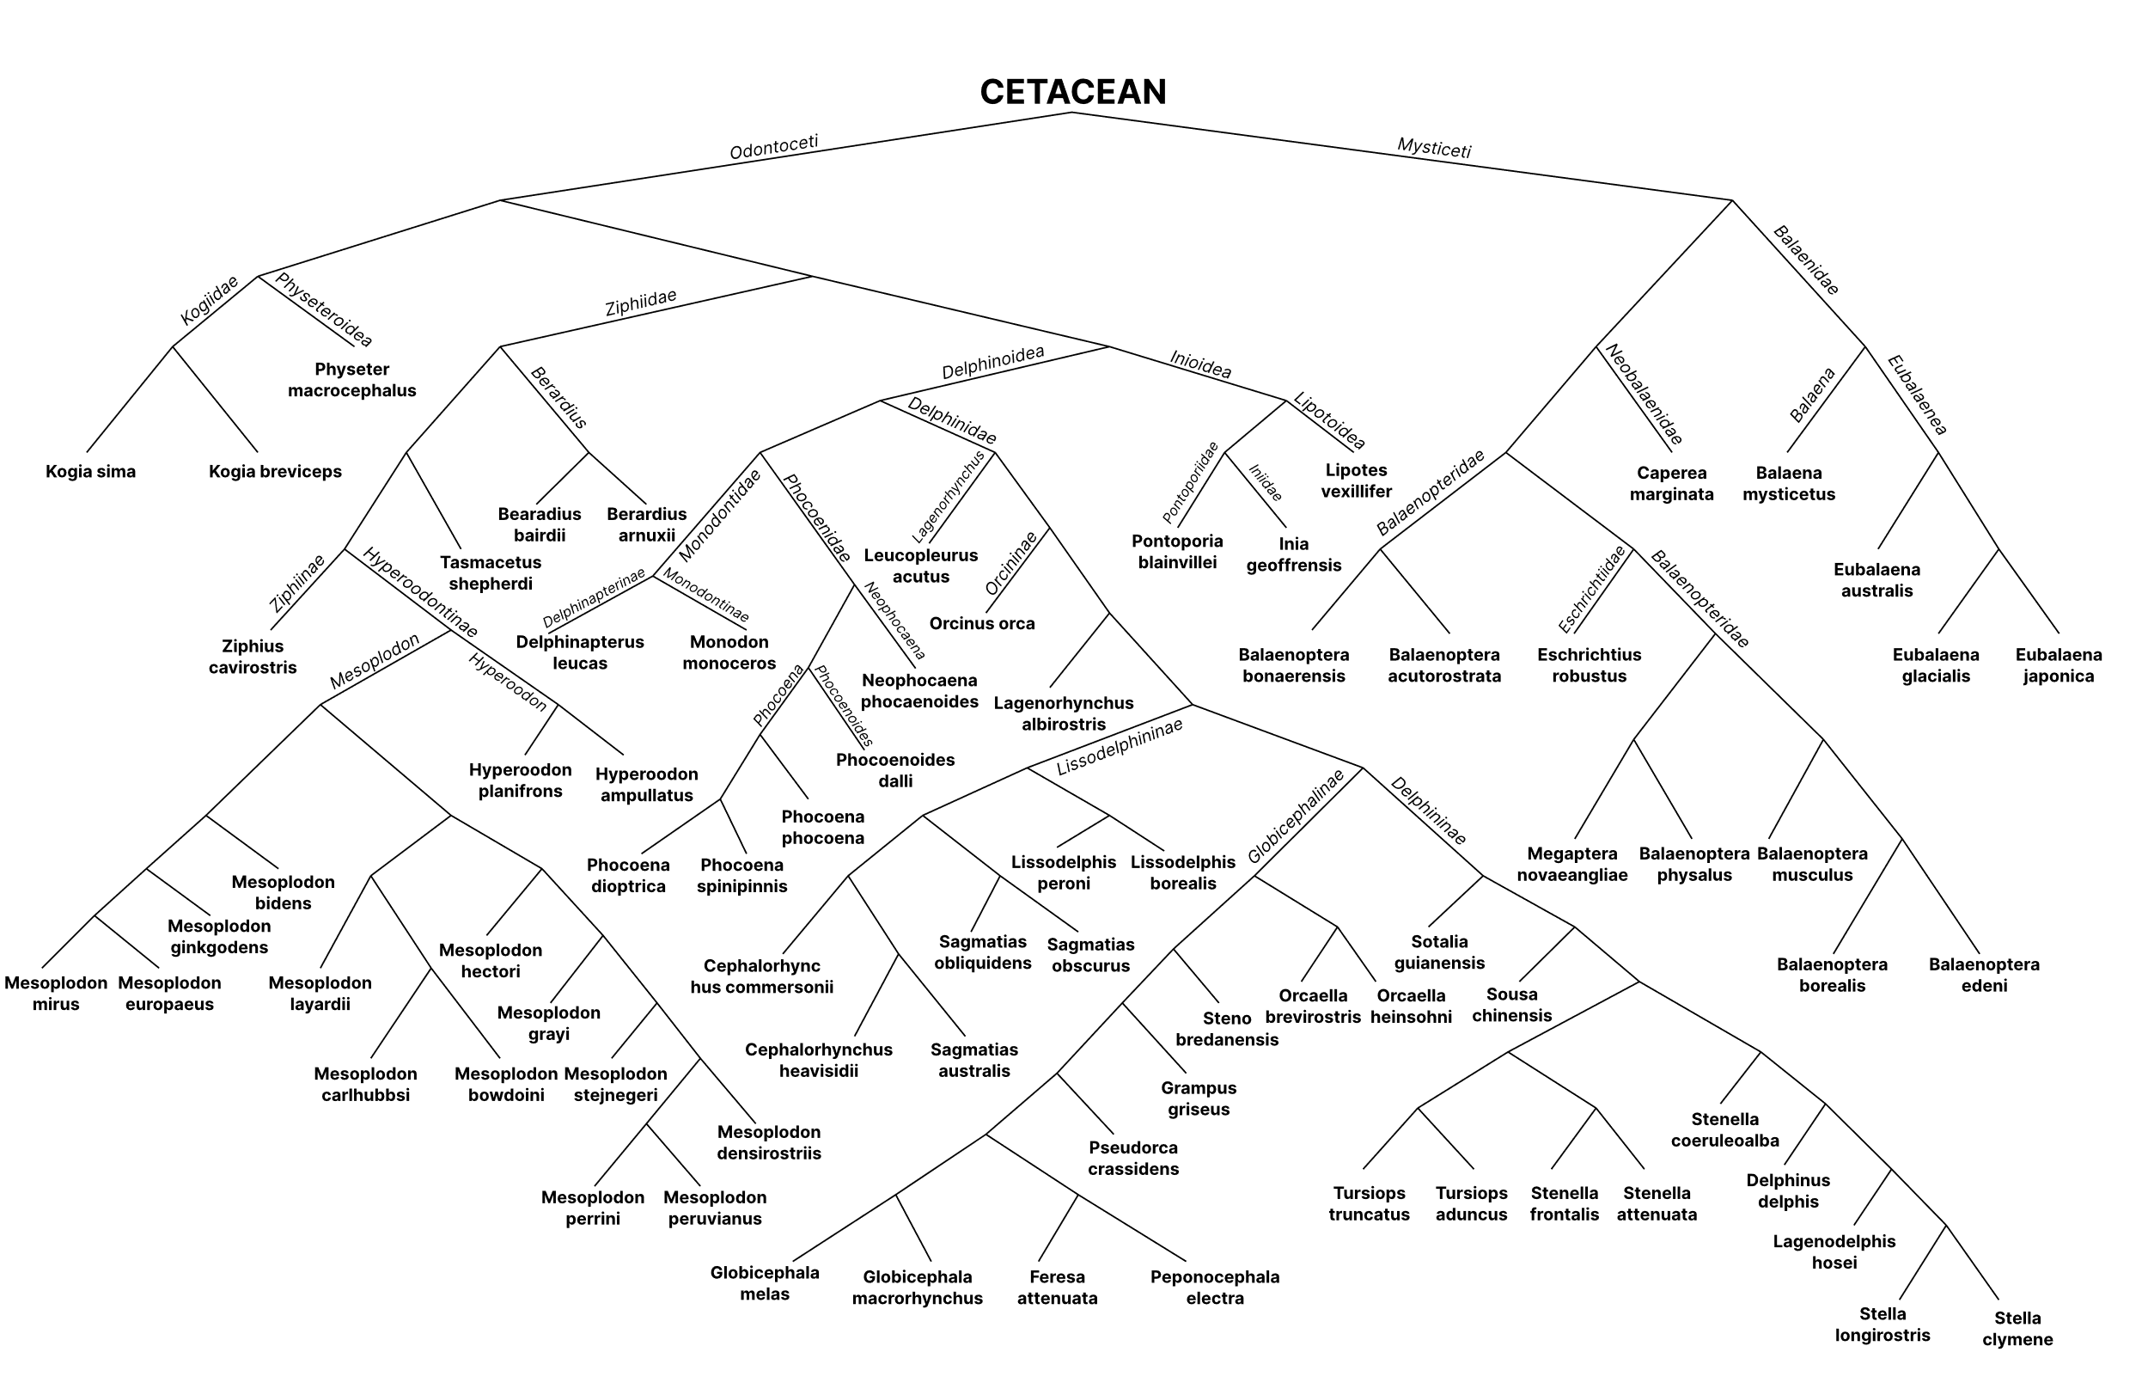
Tree of life of Cetaceans
Our starting point was the phylogenetic trees from a May 2020 Systematic Biology paper, which served as the scientific foundation for our visualization. (TODO LINK)
Our goal was to turn static data into an interactive, zoomable tree where users can explore evolutionary relationships, view taxonomic ranks, and click species names to access detailed profiles.
We refined our Milestone 2 sketches, improving node spacing for better readability at various zoom levels, TODO.
To display the tree, we tested multiple visualization libraries (e.g., [TODO]) and chose one that supported smooth zooming and panning, tooltips, and click-to-profile features.
Key challenges included:
Translating complex phylogenetic data into a digital format.
Balancing detail with simplicity.
Ensuring accessibility and responsiveness.
Nodes movements TODO
This visualization helps users understand the evolutionary relationships among cetacean species, offering an intuitive way to explore their diversity, taxonomy, and shared history.

Slide 6
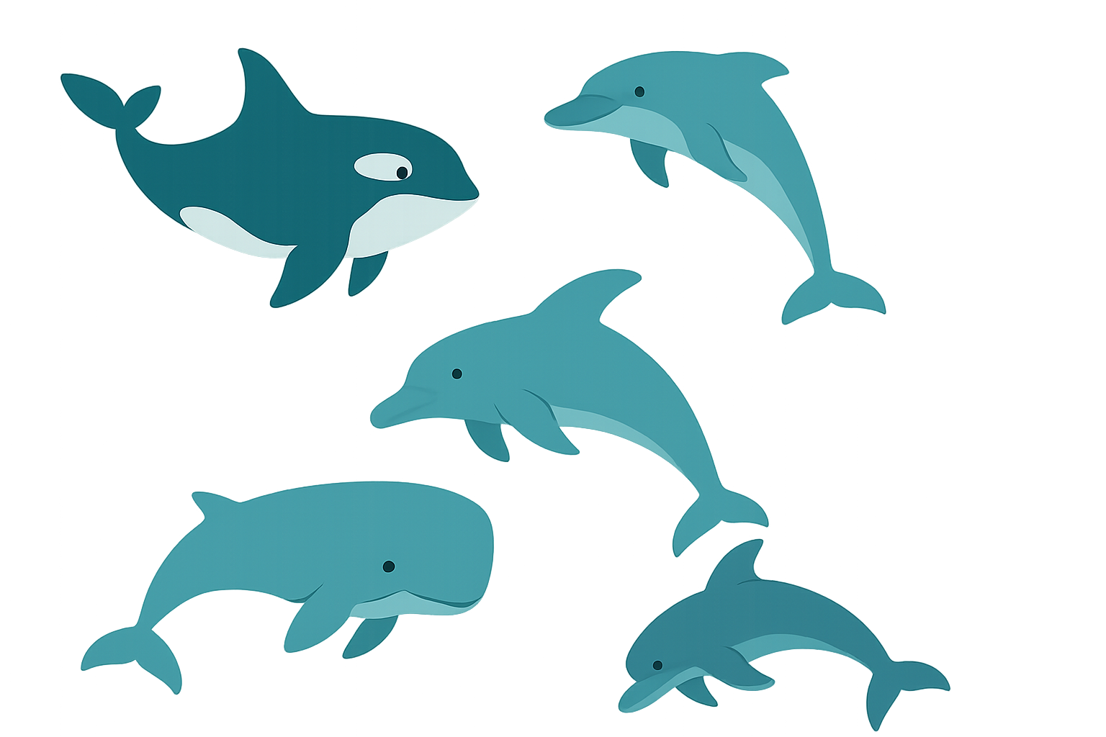
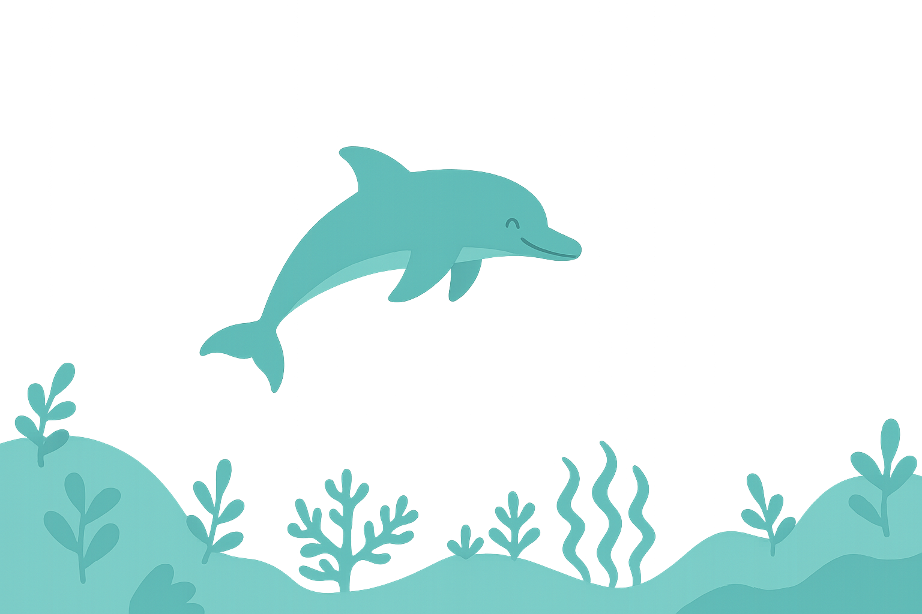
Species Profile Pages
We began by gathering basic information on all known cetacean species from the Wikipedia list of cetaceans, which includes taxonomic data, conservation status, habitat, size visuals, and images.
We developed interactive profile pages that display this information dynamically. These pages are accessible through the tree of life, the sightings map, or directly via a search bar. Using the Wikipedia API, we pull live data including species summaries, photographs, range maps, size comparisons, and endangerment levels.
In addition to Milestone 2: TODO
These profile pages help users dive deeper into individual cetacean species, enriching their understanding through accessible, up-to-date information in a centralized and interactive format.

Slide 7

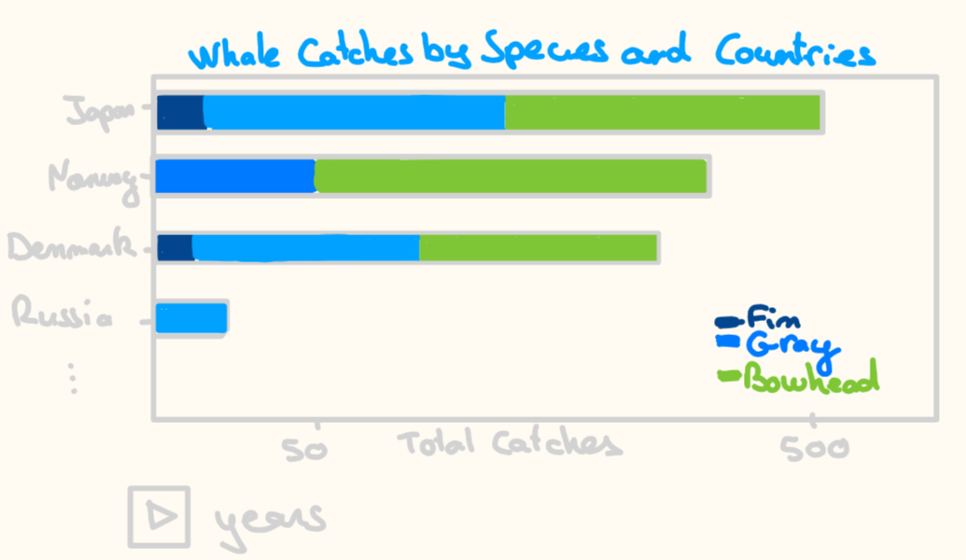

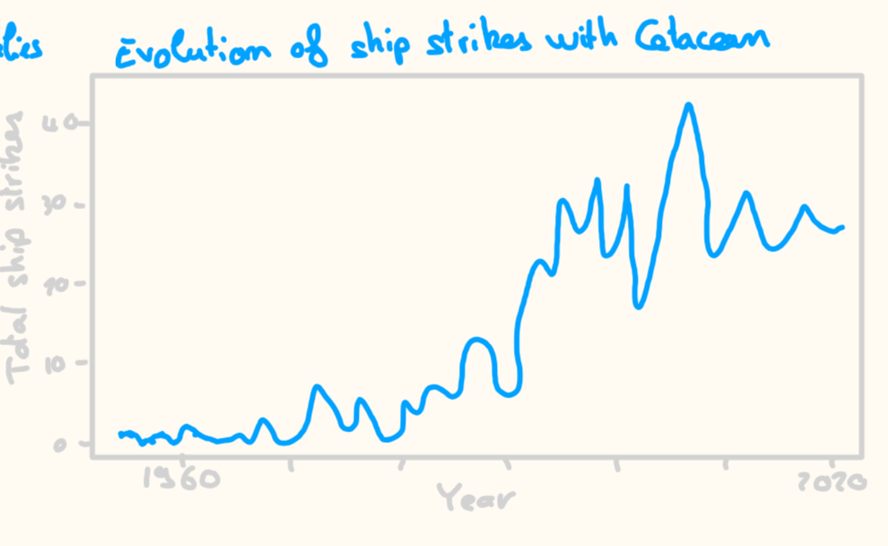
Multiple Threats to Cetaceans
To fully understand the urgency of cetacean conservation, it is
essential to explore the multiple threats these marine species currently
face. This section presents three visualizations that shed light on the human-driven and environmental pressures impacting cetacean populations worldwide.
Whaling Activities – Dynamic Stacked Bar Chart
This animation provides an engaging way to observe:
Shifting patterns in global whaling practices.
The rise and fall of whaling activities by nation.
Changes in targeted species over time.
Maritime Traffic – Ship Strike Line Chart
The second visualization focuses on the impact of maritime traffic, specifically tracking the number of reported ship strikes involving cetaceans per year. The data come from the IWC Ship Strike Database. This line chart highlights a lesser-known but serious threat: collisions with vessels, which often lead to injury or death for large marine mammals.
The visualization is a dynamic stacked bar chart, designed as a race bar chart, which visualizes the top countries involved in whaling over time. Each bar is segmented by whale species, allowing users to see both the scale and species-specific impact of whaling activities across decades, as reported by the International Whaling Commission.
The motion-driven format effectively emphasizes temporal trends, making the historical evolution of whaling efforts more intuitive and impactful.
This visualization shows how increasing global maritime traffic might be affecting whales. It aims to raise awareness about the consequences of expanding global trade and shipping routes on marine life.

Slide 8
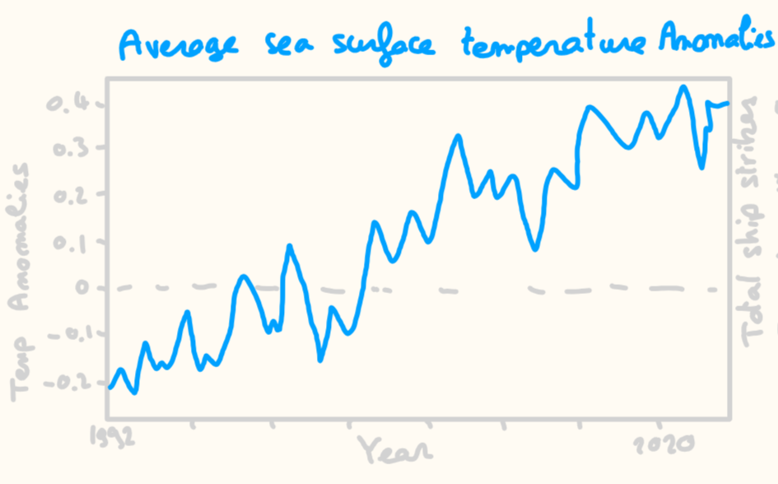
Climate Change – Sea Temperature Line Plot
The final chart presents the average sea surface temperature over the years in a line plot, offering a perspective on climate change as a growing threat to marine ecosystems. Climate disruption data is sourced from Copernicus, which offers global monthly average sea surface temperature anomalies from 1993 to 2021. When interpreted alongside our cetacean sightings map, this chart enables exploration of a critical question: Are changes in ocean temperature influencing cetacean migration routes?
III. Challenges
Incomplete Geospatial Data. Many sighting datasets lacked precise coordinates, often listing only countries. To build our map, we manually combined and cleaned multiple datasets, one for each species.
Complex 3D Map Implementation. Building the 3D map with D3.js was challenging due to its low-level nature. Much had to be implemented manually, and in hindsight, using a higher-level library like Three.js or Kepler.gl would have saved time and effort.
By encouraging this cross-analysis, users can begin to draw connections between environmental trends and behavioral shifts in marine species, reinforcing the complex and interlinked nature of the threats faced by cetaceans today.

Slide 9
IV. Conclusion and Future Improvements
………….
V. Peer Assessment
…..

Slide 10
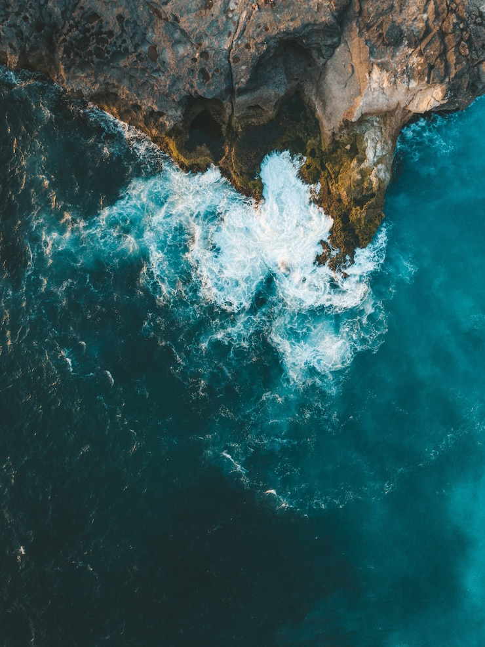
COM-480 ~ Data Visualization
Cetacea
Vanishing Giants – Mapping the Past, Present, and Future of Cetacea
~ Where Were Whales ~
Camille Challier
Cyrill Strassburg
Eglantine Vialaneix

Slide 11
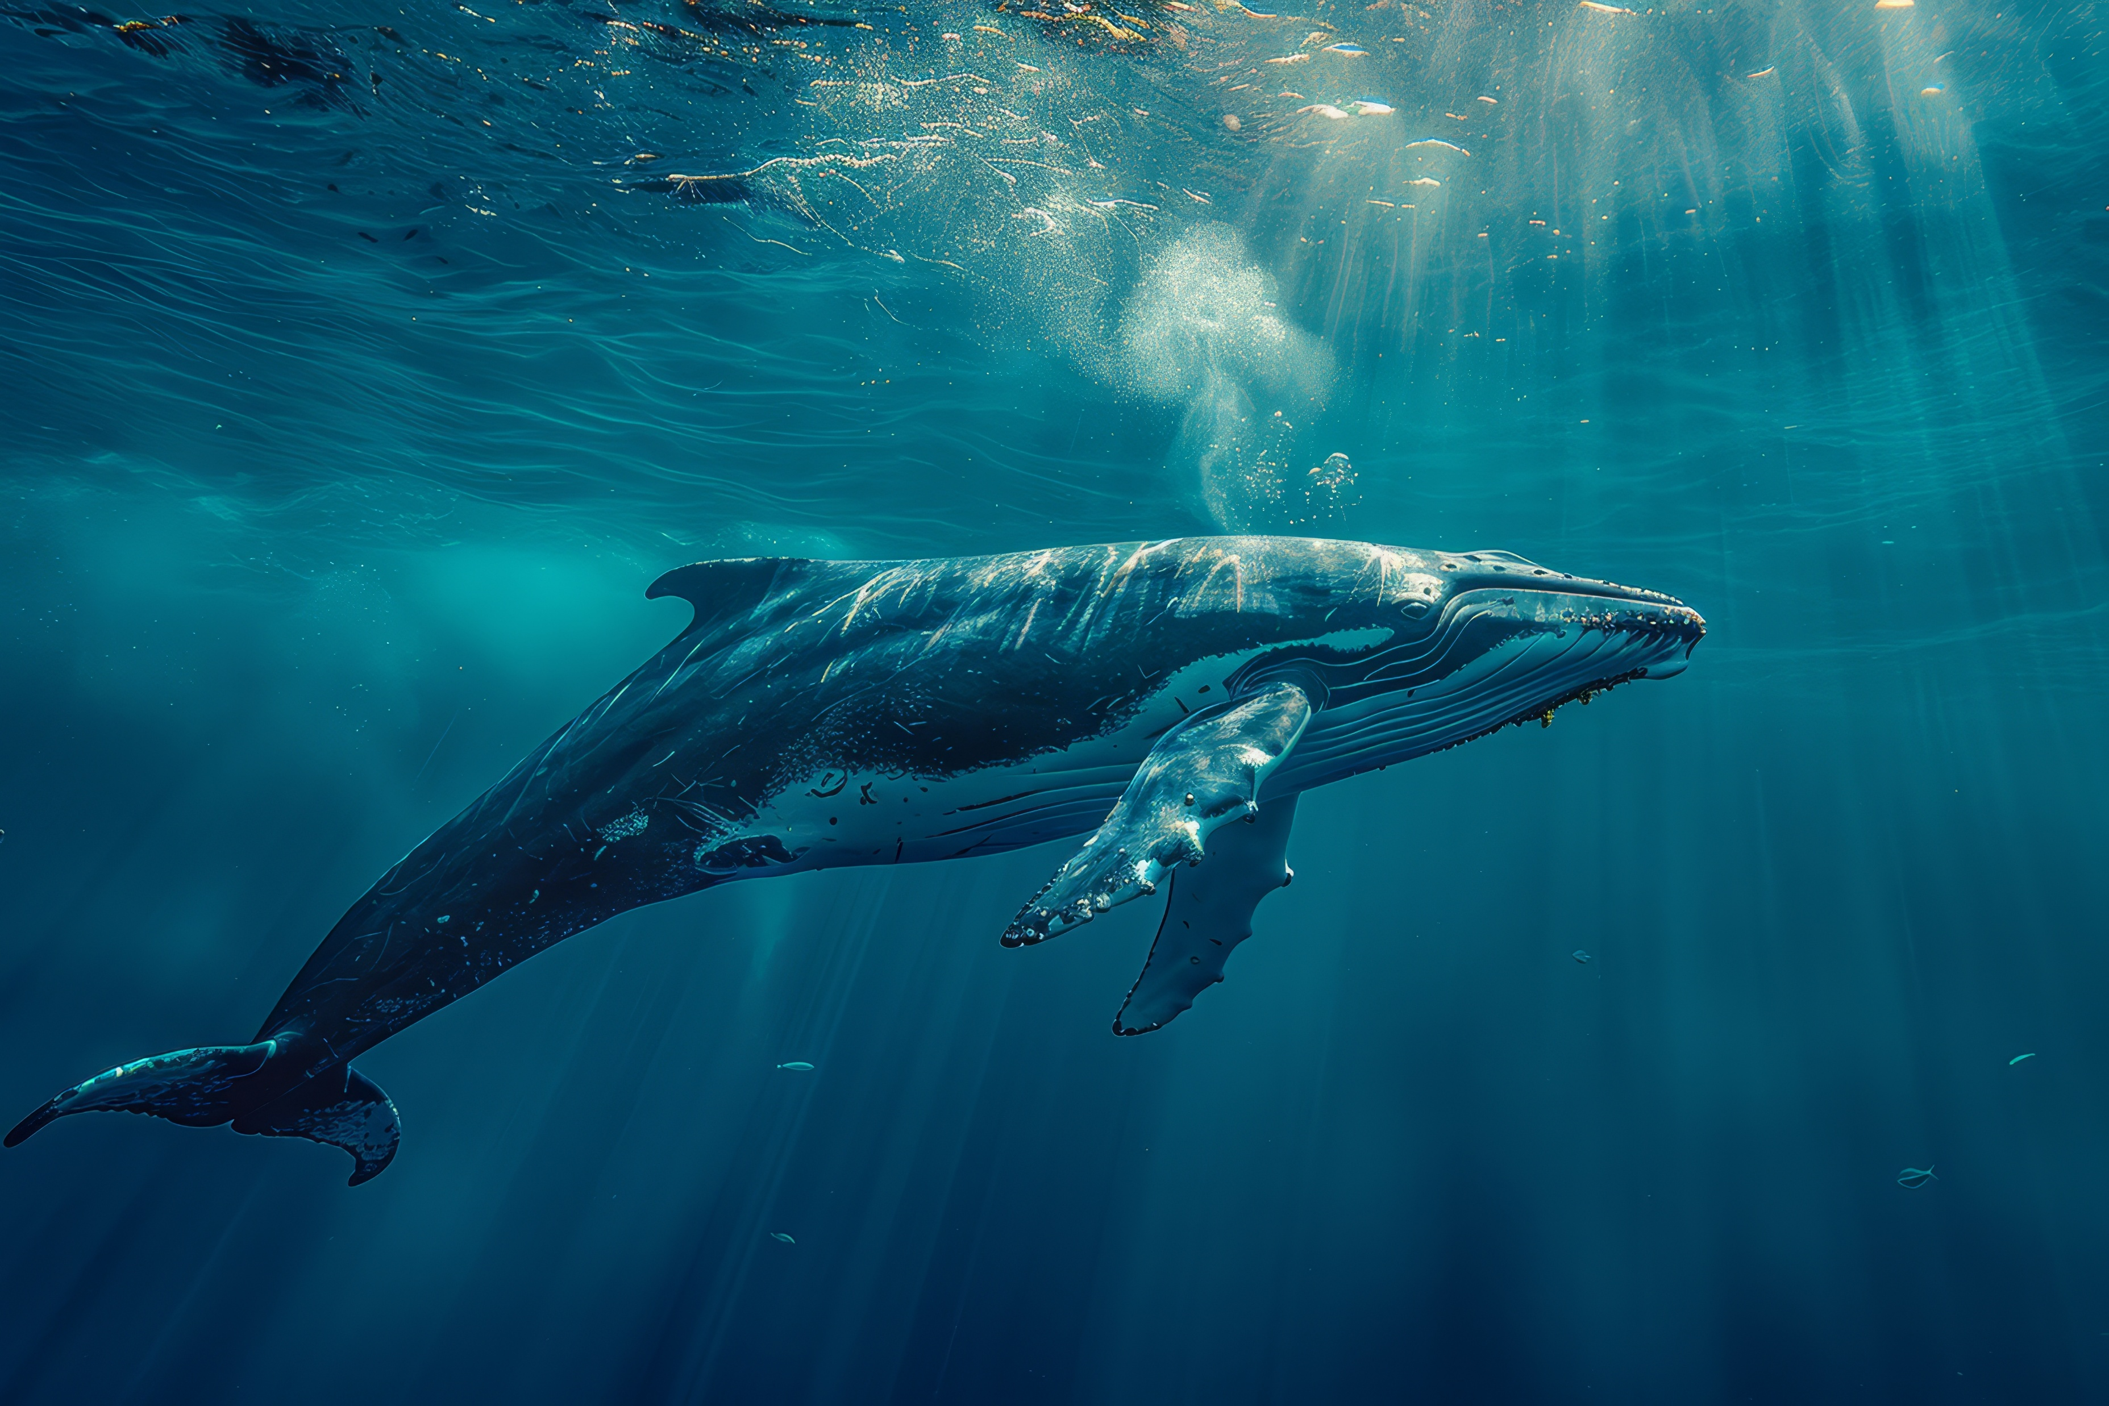

Where Were Whales
1

